Slide 1


A-State Ambassador Assessment
Mr. Chad Whatley
The Honors College
March 14, 2018

Slide 2


Slide 3

Honors Ambassadors
111 Honors Ambassadors for 2018 – 2019
Formal application process
Assist with Honors special events and recruitment activities
Assess “Communication” (University Learning Outcome)

Slide 4
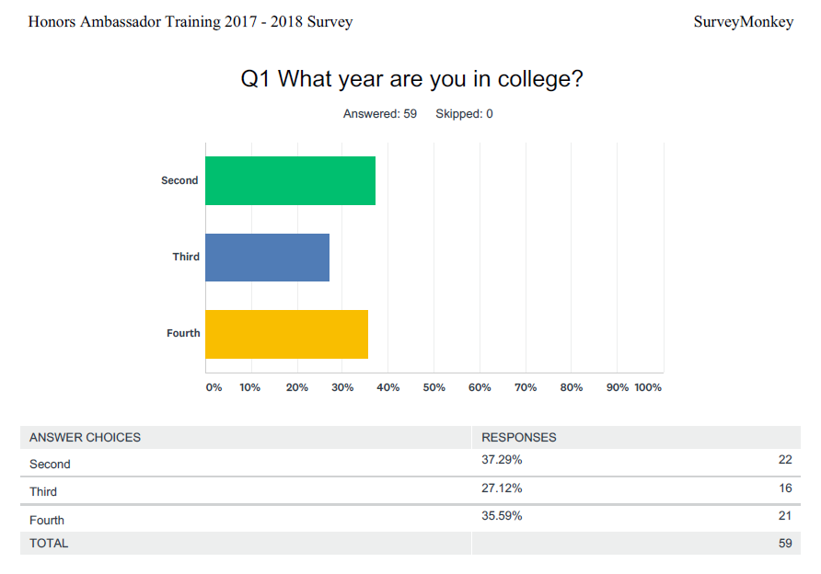
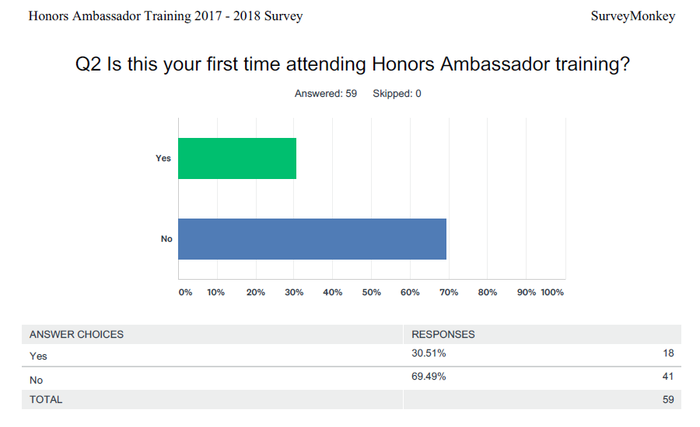
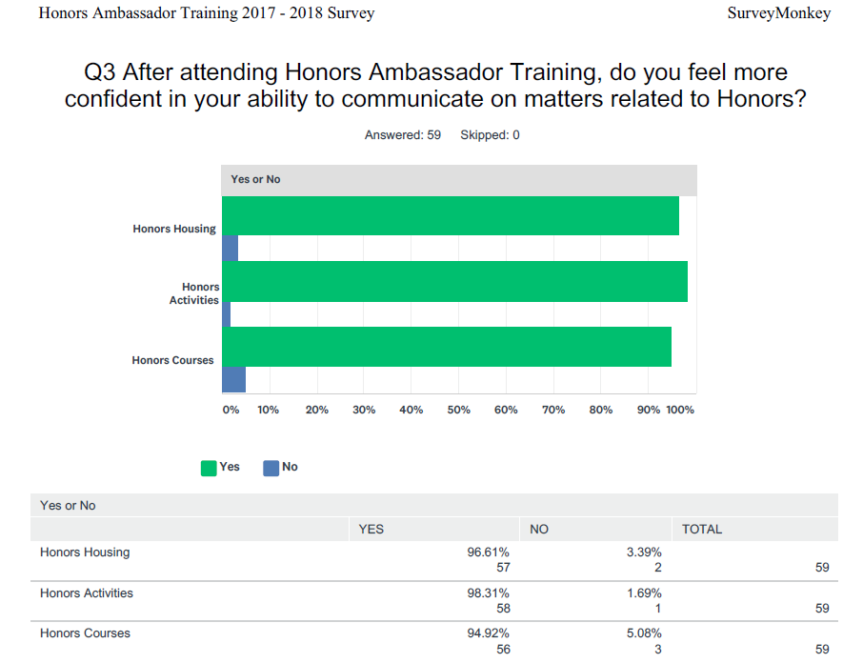
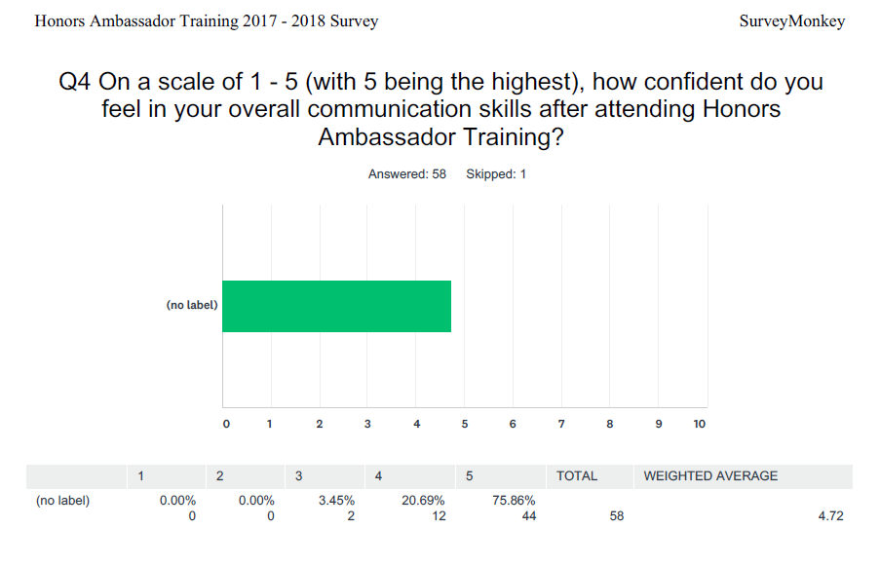

Slide 5
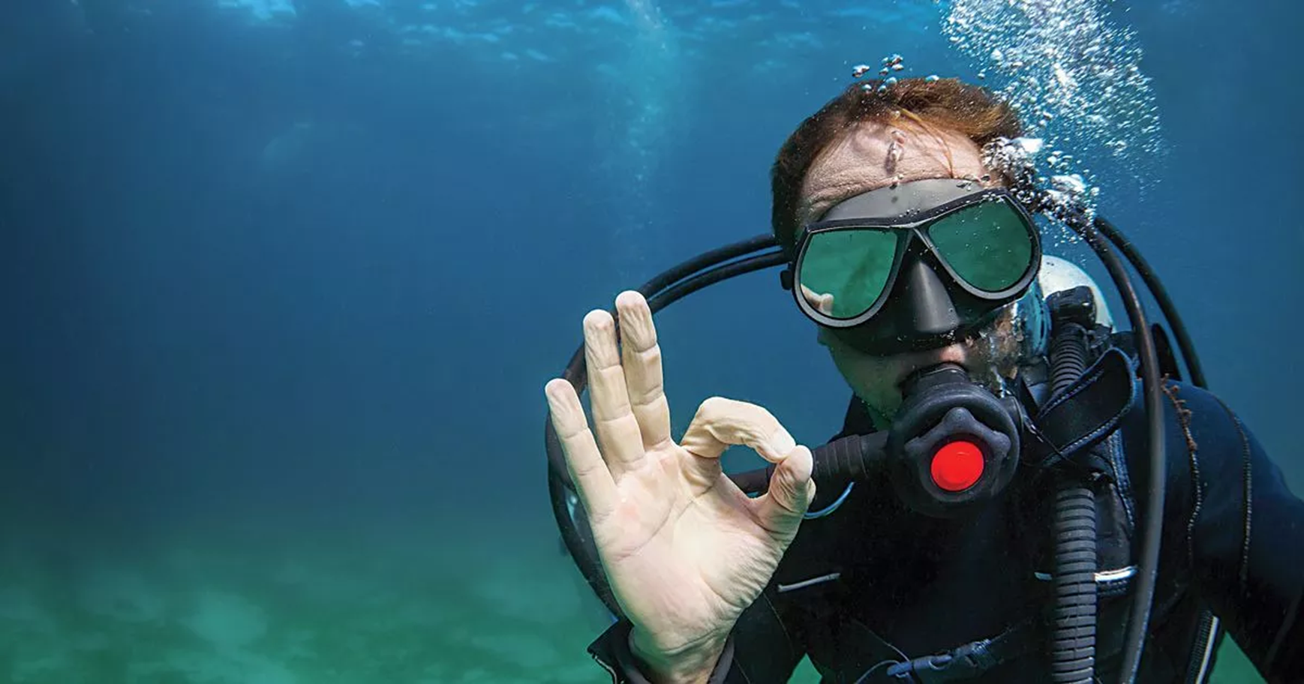
DIVE DEEPER…

Slide 6
Ambassador
Group Task Force
All “Ambassador” program advisors
Regular meetings
Shared online resource page
  Information about each ambassador group
  Platform to share assessment practices
  Collaborations across departments

Slide 7
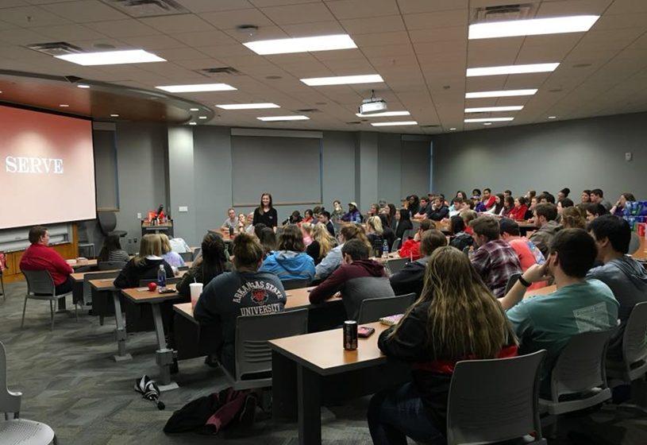

Slide 8
Ambassador
Assessment
All Ambassador Training on 2/28
74 students in attendance
Survey administered
Future collaborations being discussed

Slide 9
Learning Opportunities
What programs are high student learning opportunities?
What services do you provide the campus?

Slide 10
THANK YOU!!!
Chad Whatley
Honors College

